Slide 1

SAGE gameful Constructionism Assessments and Analytics
Tim kartawijaya
Johan sulaiman

Slide 2

agenda
MOTIVATION
RELATED WORK
PROPOSAL
MILESTONES
FUTURE WORK

Slide 3
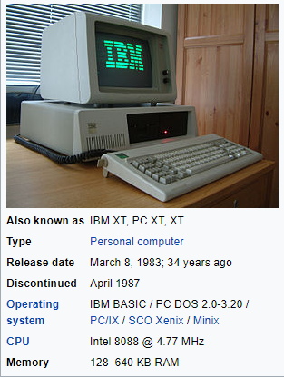
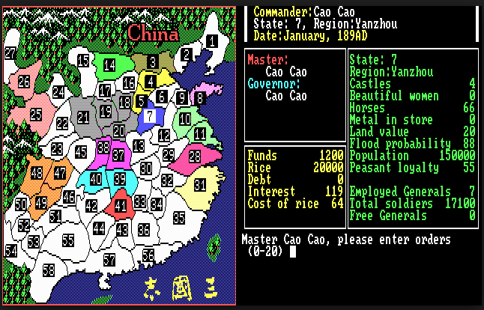
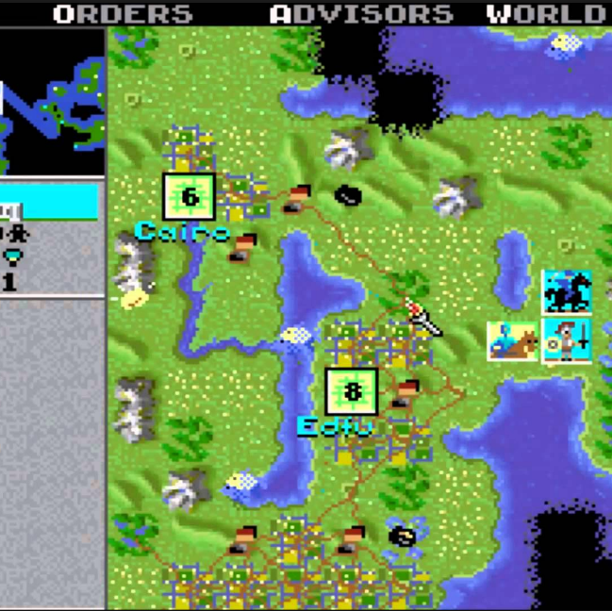
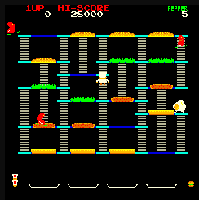
personal Motivation from an overcommitted gamer
Gaming is my life’s first passion. Started with Burger Time and in PC XT, but Civilization I(!) and ROTK sealed my enduring life-long love affair with games. It brought me immense happiness internalizing the growth, accomplishments, and the evolving game world of my character, team, or civilization into my real waking moments.
I later realized that my game playing sessions were my safe, controlled, simulated projections of how I want my ideal life to be. But I fell into the too common trap to permanently migrate and stay in the safe and controlled game world. I learned the hard way it would be a tragic waste of time, passion and potential if gamers who have worked hard in gaining virtualized skills and experiences could not convert these investments in their day-to-day lives.
Now that I have little children, I want to find ways for them (and their friends!) to turn highly enjoyable and rewarding game playing into directly translatable life skills, incentivizing them from mere Player of games into Constructionists in simulated game worlds, and in the real world where it matters the most.

Slide 4
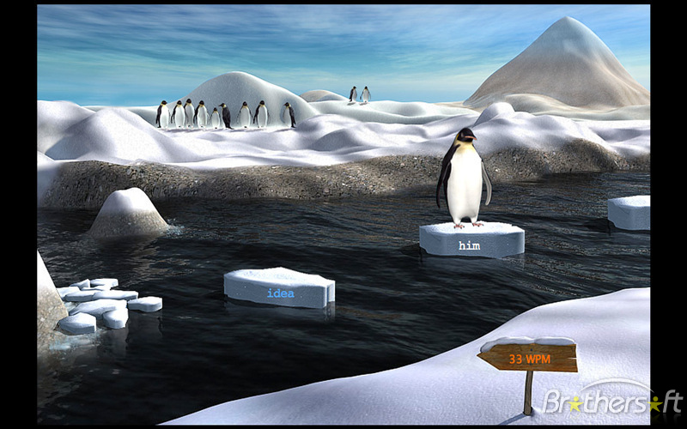
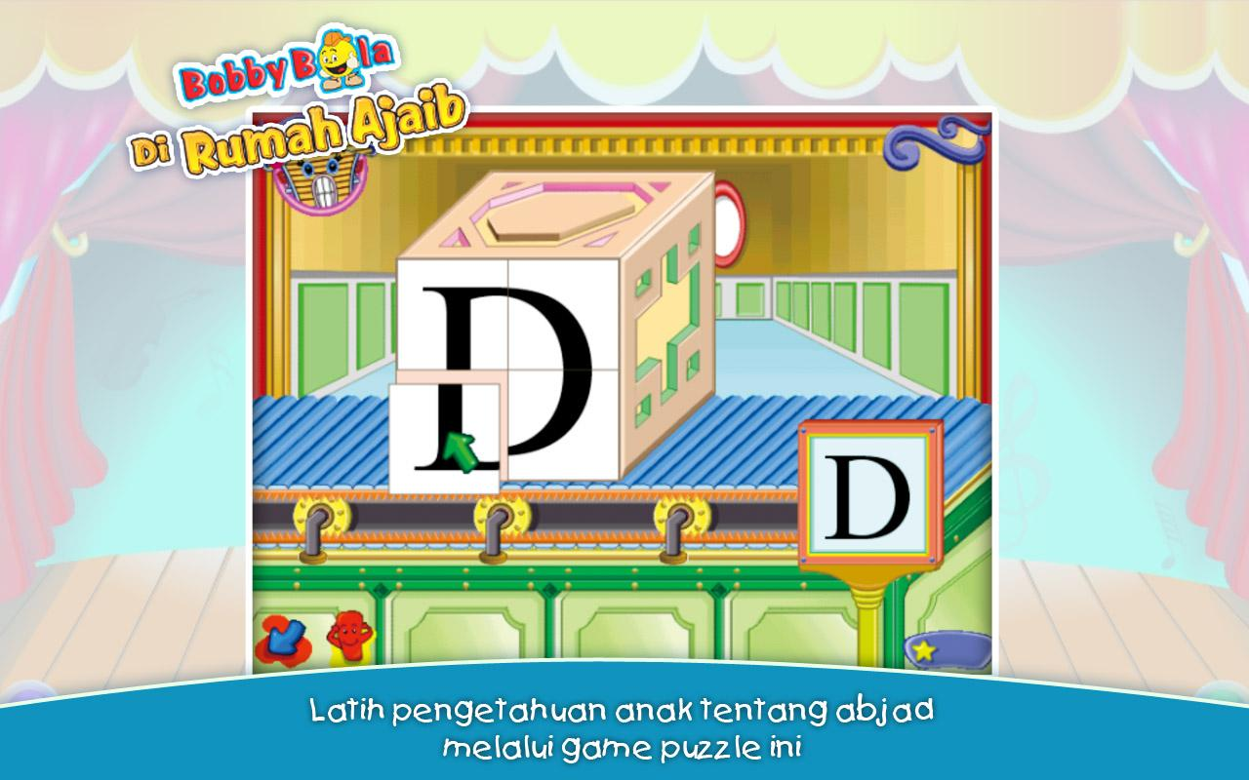
PERSONAL MOTIVATION FROM A SOMEWHAT COMMITTED GAMER
I was also a kid that grew up learning by games
I remember spending hours on a “typing” game to improve my typing speed
CT thinking is applicable not only in CS but humanities and social sciences
There is a need of CT thinking in current and future generations, as we progress to a more technology dependent world
I believe that through gamified environments , future generations are able to improve CT thinking to move in to techy future
Notes:
Like Johan, I also grew up with games but not as much as intense as Johan. But the games that I remembered playing as a young child are actually gamified learning environments. I remembered spending hours on a ”typing game” with a goal of being the fastest type in the class. I remembered the thrill that I got when I was able to spend class time learning how to build alphabets using the computer. My childhood experience verified my belief in the effectiveness of gameful education.
Additionally, being in a liberal arts school, I get to interact with people and classes in the humanities and social sciences. I can’t help but think of how applicable CT thinking is to all fields, as they help me form arguments and communicate ideas in my classes. Furthermore, I believe that there is a need in CT thinking for future generations, as fields are more computationally dependent than ever before.
I believe that through gamified environments like SAGE, future generations can be equipped in CT thinking so that children today can succeed in a more technological world.

Slide 5

motivation– three years of sage at a glimpse
Tooling Scratch – Jeff Bender
1
Formative SAGE Assessments – Jairo Pava
2
Foundations for Gamification for Formative SAGE Assessments – Iris Zhang, Julie Chien, Ray Tsai
3
SAGE Assessments Parson’s Puzzles - Akanksha Gupta, Sudhanshu Mohan
4
SAGE Dashboard – Ruicong Xie, Tianci Zhong
5
Enhanced Data Collection, Student Progress Modeling, and Intelligent Hinting in SAGE– Sambhav Anand, Allison Sawyer
6
Computational Thinking Learning Platform for SAGE - Sajal Khandelwal, Plaban Mohanty
7
… and more to come!

Slide 6
motivation–sage modules
Scratch Analyzer
Visual Assessment Server
Visual Assessment Editor
SAGE Scratch Editor
SAGE Dashboard/
Affinity Space

Slide 7
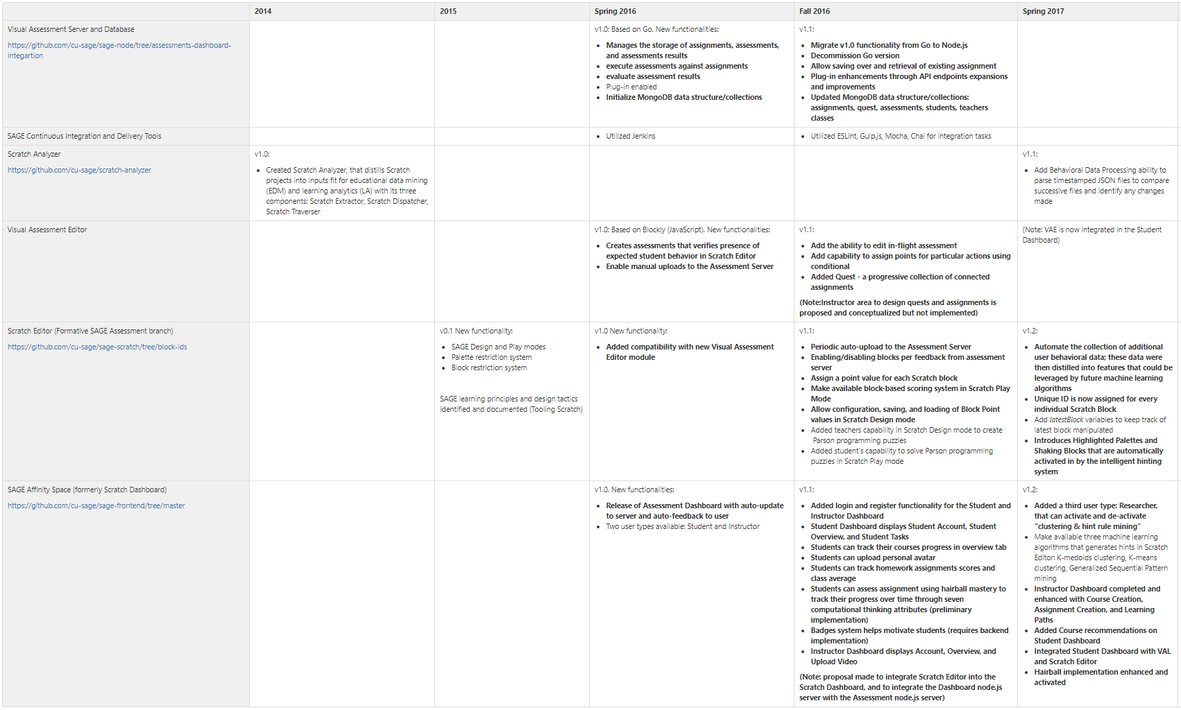
Evolution of SAGE Modules and Functionalities
https://gudangdaya.atlassian.net/wiki/spaces/SAGE/pages/60293127/Getting+Started

Slide 8
motivation– theme from the past: we want to experiment with more users and more data!
Feedback loop for machine learning algorithm: “Eventually, it will be necessary to have a larger sample of student users in the target sixth- to eighth-grade range try SAGE. This student data would strengthen models of how different clusters of students approach puzzles. It would also allow for empirical evaluations of the usefulness and appropriateness of the hinting system.” – Allison, Sambhav
“Also, as we propose to open this platform to the community, over time we may have influx of courses of different qualities. Instead of manually implementing quality control with human intervention, we propose to implement a rank based model identify better quality courses. The rank could be calculated in combination of factors like users’ ratings, number of completed courses, comprehensiveness etc.” – Sajal, Plaban
“Does gamified SAGE work better than regular SAGE?” – Julie, Iris, Ray
Notes:
Another aspect of this proposal as indicated from the title is: analytics. From previous developments of SAGE, there has been a common theme of the need to quantitatively assess the effectiveness of SAGE gamification features. We want to know how SAGE performs in developing CT thinking compared to regular Scratch. Additionally, we want to know if a gamified SAGE is more or as effective as regular SAGE, as the previous report by Julie, Iris, and Ray indicates.

Slide 9
motivation– …which requires a more generally accessible unified implementation
“Building a one-stop platform for SAGE, all components - Dashboard, Scratch Editor, Visual Assessment Language etc. under one web platform may lead to better engagement” – Sajal, Plaban
“Combine Front-end website, SAGE editor, and SAGE assessment server into a single repository and server. Integrate the SAGE editor into current dashboard design” – Ruicong, Tianci
“Improve service architecture to make the assessment editor more integrated with the rest of the SAGE and Scratch suite. Create a live server using Heroku or OpenShift” – Julie, Iris, Ray
“"An evaluation of the project should be conducted in a classroom environment where its strengths may be built upon and its weaknesses addressed. Future work should aim towards further analysis of how the puzzles can be designed in this project can be improved to better capture a student’s computational thinking progress over time." - Akanksha, Sudhanshu

Slide 10
Project Motivation
The past 3 years of SAGE development has created various modules and functionalities. Our continued focus remains in maximizing Social Addictive Gamefulness during instillation of computational thinking especially during assessments of Gameful Constructionism learning, but with the added awareness that there is also a growing need to provide up-to-date, unifying structure on the conceptual and architectural level with a Gameful orientation. In an iterative manner, during the process of building a platform that supports Engineering activities, the platform itself requires frequent (Re-)Engineering. Achieving this will allow for better cross-module integration, research clarity, and enablement of a more formal experimentation and evaluation of the effectiveness of SAGE modules.

Slide 11
Related work – constructionism Papers
Construction tools must be sufficiently expressive to allow sufficient range of freedom that yields creativity, and in-game goals should encourage exploration (“Redefining constructionist video games”, Weintrop et al, 2012)
In particular, constructionism is itself resistant to grading, ranking, and classifying children as bad/underachievers, because inherent in the idea of constructionism is that all students can engage in deep learning if the environment, tools, and facilitation are well-designed (Berland et al, 2014)
Constructionist games do provide a wealth of unstructured data conducive for application of data mining techniques (Berland, Baker, Blikstein, 2014)
So how to best assess constructionism given this challenge?
https://gudangdaya.atlassian.net/wiki/spaces/SAGE/pages/75595790/Theoretical+Foundation

Slide 12
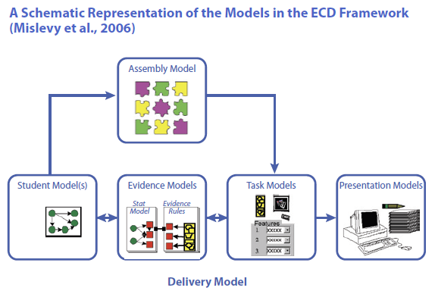
Related work – ECD Papers
“Evidence-centered design of epistemic games” (Rupp et al, 2010) and “Serious games for learning” (Carvalho, 2017):
a learner’s performance data is continuously collected from the game, and machine-based reasoning techniques are used to make inferences about the learner’s competences across a network of competences and skills resulting in a learner model. It is argued that stealth assessment and ECD are able to assess not only content-specific learning but also general abilities, dispositions and beliefs, thus being more adequate to assess the so-called 21st century competences (problem-solving skills, persistence, creativity, etc.)
As any empirical measurement, assessment in learning has two important properties: reliability and validity. Reliability refers to the amount of error in a test, or the extent that the assessment yields the same results on repeated trials; validity concerns the extent that the assessment measures what it is intended to measure (Carmines & Zeller, 1979)
(Used extensively in GRE. Interestingly GRE Validity coefficients only range from .30 to .45 between the GRE and both first year and overall graduate GPA in ETS' study…)
https://gudangdaya.atlassian.net/wiki/spaces/SAGE/pages/75595790/Theoretical+Foundation

Slide 13
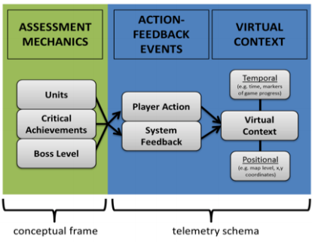
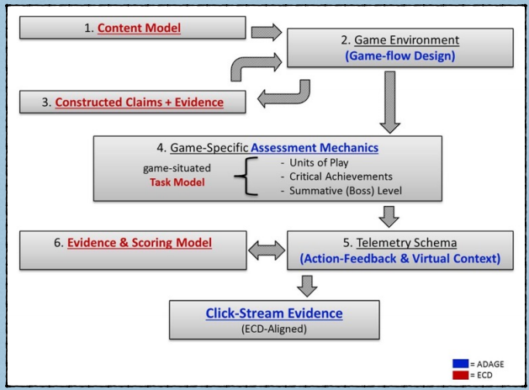
Related work – Applying ECD in ADAGE, for assessments and analytics
ADAGE (Halverson, Owen, 2014) is an open-source data collection and analysis framework that transforms real-time click-stream (telemetry) data from games and other digital learning environments into formative evidence of learning. These data can be used to identify patterns in play within and across players (using data mining and learning analytic techniques) as well as statistical methods for testing hypotheses that compare play to content models.
ADAGE offers a robust framework for defining and specifying how data from games is gathered, stored, and made available to educational researchers, game developers, and classrooms. Overall, the ADAGE framework provides rich, method-agnostic data, scales easily, and is flexible enough to use across a wide range of games and platforms
ADAGE’s context-rich data make ideal building blocks for feature engineering. Features are essentially variables of interest in the data, which can range from simple click locations to complex measures like accuracy over time. These features can then be used across a broad range of analysis techniques. Data lenses can include descriptive statistics, hypothesis-driven applied statistics, and machine learning techniques. Methodologies for hypothesis testing (like ECD) can use ADAGE data as dependent variables, independent variables, and covariates for use in associative or predictive modeling

Slide 14
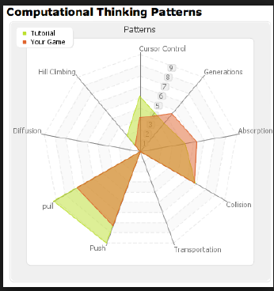
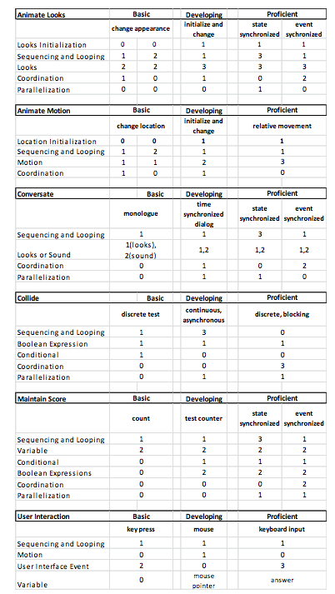
RELATED WORK – data analytics PAPERS
Progression of Early Computational Thinking (PECT) Model (Seifer et al2013):
Effective model in understanding and assessing development of CT thinking in primary grades
Real Time Assessment of Computational Thinking (REACT) (Koh et al, 2014):
a real time graphic assessment tool that quickly gives teachers insight into students’ mastery of computational thinking construct
https://gudangdaya.atlassian.net/wiki/spaces/SAGE/pages/75595790/Theoretical+Foundation
Notes:
Concerning the analytics aspect of the project, the following is some related work in the creation of a analytics framework. Here we see a paper on the PECT model which is an effective model in understanding and assessing development of CT thinking in primary grades
we hope to use this rubric model to determine how well SAGE users are in developing CT thinking

Slide 15
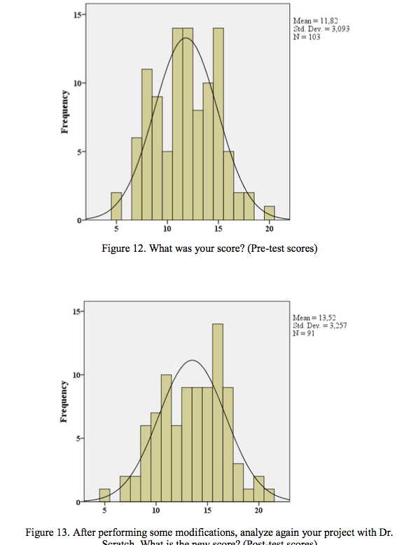
RELATED WORK – data analytics PAPERS
Dr. Scratch: Automatic Analysis of Scratch Projects to Assess and Foster Computational Thinking (2015):
Used Hairball plug-ins (Boe et al, 2013) to produce CT score from Scratch project analysis
Determined effectiveness of tool by experimental usage data
https://gudangdaya.atlassian.net/wiki/spaces/SAGE/pages/75595790/Theoretical+Foundation
Notes:
Next we are able to look at Dr. Scratch’s study in developing metrics for efficacy studies on SAGE.
Dr. Scrath uses hairball plug ins…
Slide slide
We aim to do something similar to Dr. Scratch, the difference is we will be using PECT as our rubric and including a baseline data from Scratch 1.0.

Slide 16
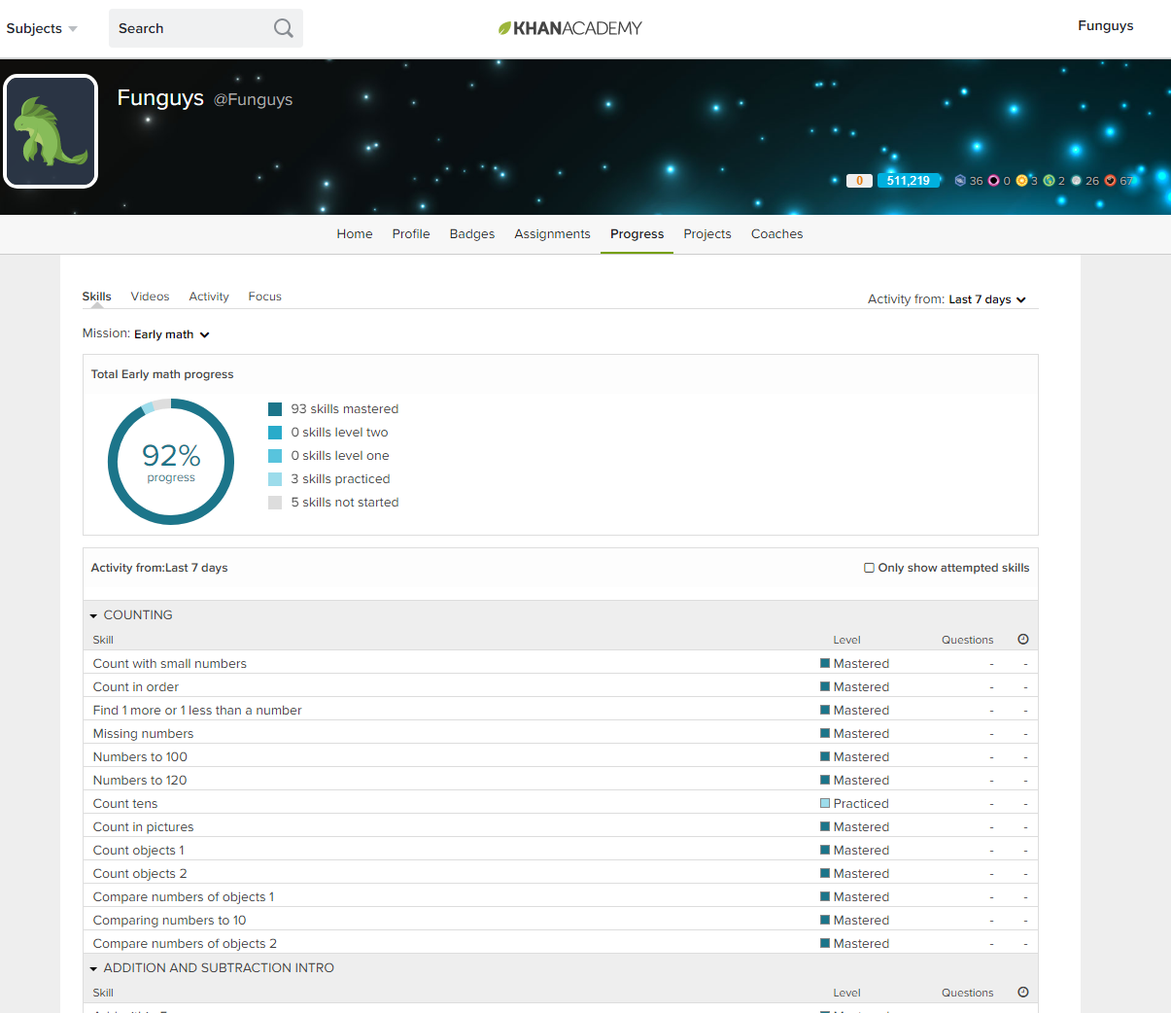
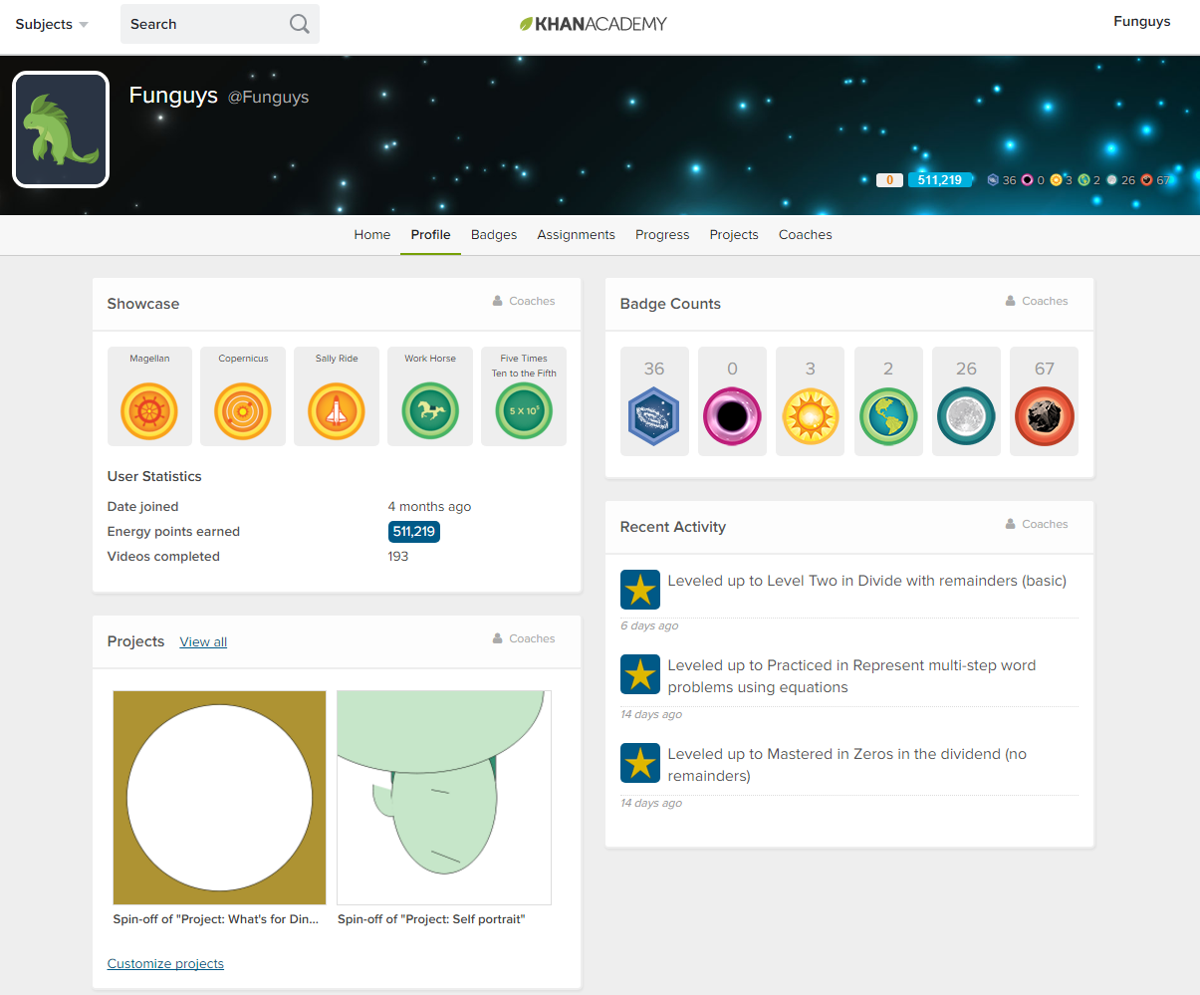
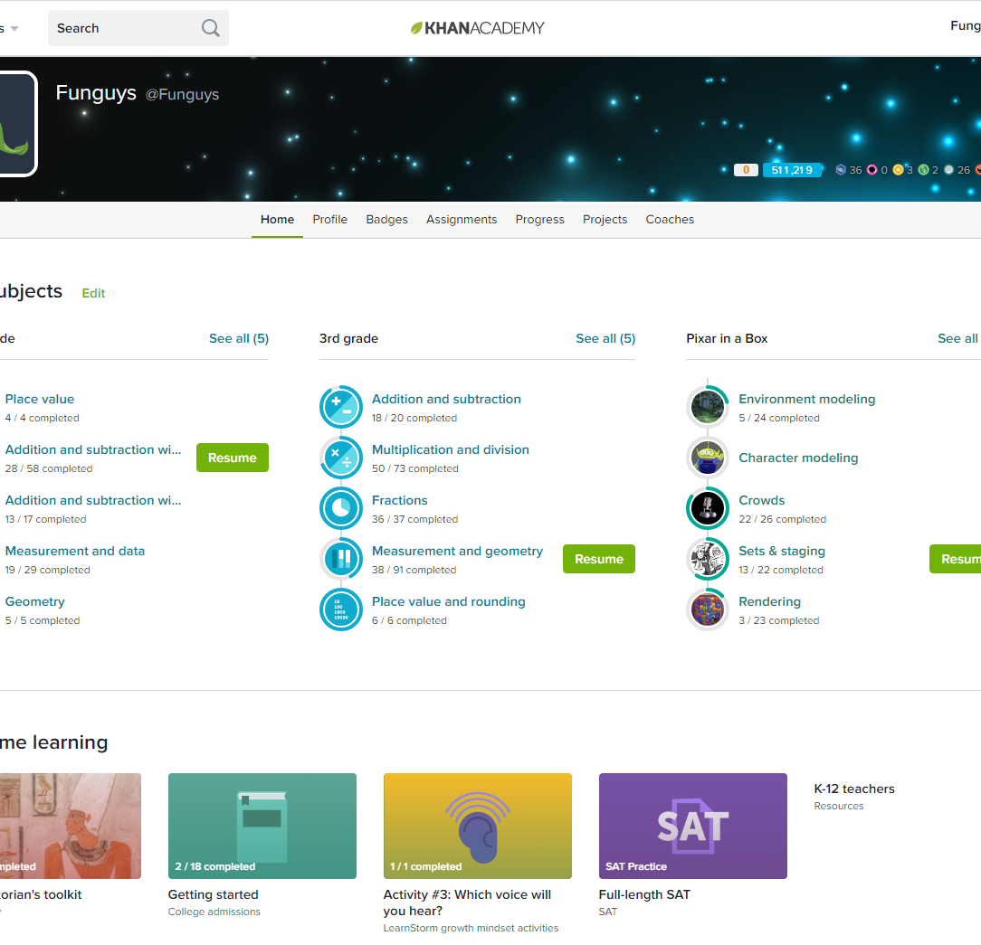
Related work – Khan academy
Tight and unified integrations of front-end and back-end functionalities in production mode
Gamified Accomplishments…
…and Persistent Progress

Slide 17
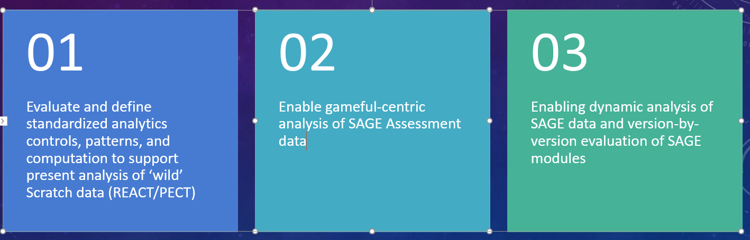
Proposal – realize a gameful evaluation system and analytics framework
Proposed parallel tracks that are in-sync and inform each other:
Assessment
Enable real-time Gameful assessments in the Node.js version of SAGE to support Gameful Constructionism usage of Scratch
1
Overhaul fun and inviting Game Objectives in a Gameful UI (Point value, Progress Bar, Quantification of Assessed Steps)
3
Persistent Gameful progress keeping, completion, summary, tracker
4
Translation of the terminologies and structure into a shared and unified nomenclature defined within the SAGE Gameful Framework (ECD/ADAGE)
2
Analytics

Slide 18
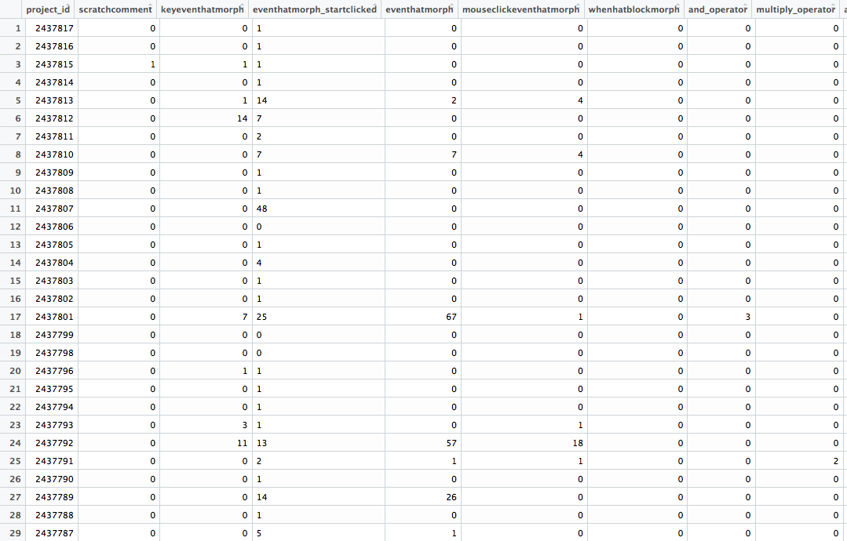
BASELINE DATA - SCRATCH “WILD DATA”
Each column represents the frequency counts of each block type for a particular project
Value of each cell represents the number of times a particular block is used in a particular project.
Notes:
Here we see the scratch wild data, (description of data)

Slide 19
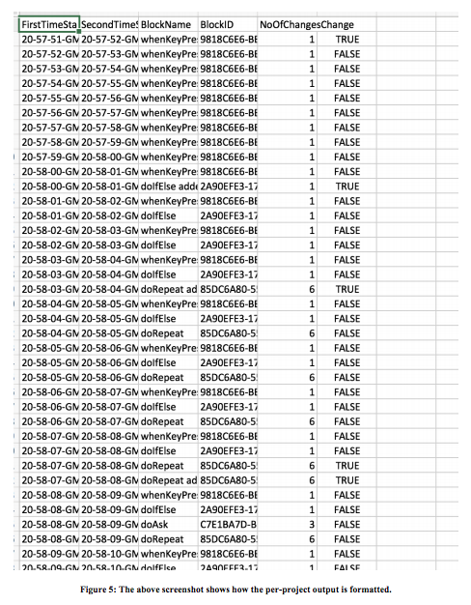
SAGE DATA - SCRATCH ANALYZER
Work by Anand and Sawyer enables extraction of data similar to format of baseline data
Notes:
Thanks to the work by Anand and Sawyer, here we have data from a project in SAGE, with a similar format to the baseline data, where all the blocks used in the project are recorded.

Slide 20
PROPOSAL – ANALYTICS FRAMEWORK
Extract data into proper format for data analysis
Calculate proficiency score of SAGE and ‘wild’ data evidence-centered design rubric
Perform analysis and compare results
Streamline analytics process and integrate to SAGE for future usage
Notes:
The data analysis process that we propose is as follows
Streamline extraction of data from SAGE into proper format for data analysis software (R, Python)
Design a system to calculate proficiency score for each project from SAGE and wild data based on evidence-centered design rubric (PECT)
Perform analysis on both data sets and compare results
Integrate the process to SAGE so that this analytics process is easily used and modified for future developments of SAGE versions

Slide 21
milestones
10/12
Current State Development Environment Setup
11/09
Successfully port and verify all Go-based Assessment Server functionalities to Node.js
11/09
Create a SAGE data analytics framework to support dynamic analysis of 'wild' and SAGE scratch data
11/30
Complete baseline analysis using SAGE data analytics framework against wild Scratch data
11/30
Add Gameful Constructionism enhancements into the Assessments module
12/07
Final Report
12/21
Software Documentation, SAGE Wiki update, and Code migration to Github repositories

Slide 22
Future work
Create a story for each concept (Conditionals, Data, Events, Loops), practice, and perspective outlined in the curriculum
Guidance on where to start when entering Construction mode in Scratch Design mode
Creation of the Game Mechanics Block to support constructionist game design
Setup A/B Testing capabilities of SAGE Features
Availability of Constructionism Granularity Slider as design aid for teacher

Slide 23
Core references
Bender, J., 2014. “Scratch Analyzer: Transforming Scratch Projects into Inputs Fit for Educational Data Mining and Learning Analytics,” Columbia University, New York, NY
Bender, J., March, 2015. Tooling Scratch: Designing a Collaborative Game-Based Learning System to Infuse Computational Thinking within Grade 6-8 Curricula - Midterm Paper" Columbia University, New York, NY
Berland, M., Baker, R.S. & Blikstein, P., 2014. Educational Data Mining and Learning Analytics: Applications to Constructionist Research. Technology, Knowledge and Learning, Volume 19, Issue 1-2, pp 205-220.
B. Boe et al., 2013. "Hairball: Lint-inspired static analysis of scratch projects," in Proceeding of the 44th ACM technical symposium on Computer science education
Carvalho, M. B., 2017. Serious games for learning : a model and a reference architecture for efficient gamedevelopment Eindhoven: Technische Universiteit Eindhoven
Groff, J., Clarke-Midura J., Owen, V.E., Rosenheck, L., Beall, M., 2015. Better Learning in Games: A Balanced Design Lens for a New Generation of Learning Games
Koh, K. H., Basawapatna, A., Nickerson, H., Repenning, A., 2014. Real Time Assessment of Computational Thinking, IEEE International Symposium on Visual Languages and Human-Centric Computing, Melbourne, Australia
Kickmeier‐Rust, M. D. and Albert, D., 2010. "Micro‐adaptivity: protecting immersion in didactically adaptive digital educational games," Journal of Computer Assisted Learning, vol. 26, no. 2, pp. 95-105
Halverson, R. & Owen, V.E., 2014. Game-Based Assessment: An Integrated Model to Capture Evidence of Learning in Play. International Journal of Learning Technology, 9(2), 111–138M. D. Kickmeier‐Rust and D. Albert, 2010. "Micro‐adaptivity: protecting immersion in didactically adaptive digital educational games," Journal of Computer Assisted Learning, vol. 26, no. 2, pp. 95-105
SAGE Wiki. (2016, September). Columbia Programming Systems Lab. Retrieved September 2016, from SAGE Wiki: https://gudangdaya.atlassian.net/wiki/spaces/SAGE/pages/60293127/Getting+Started
Seiter, L. and Foreman, B., 2013, August. Modeling the learning progressions of computational thinking of primary grade students. In Proceedings of the ninth annual international ACM conference on International computing education research (pp. 59-66).ACM
Wing, J. M., 2006. "Computational thinking," Communications of the ACM, vol. 49, no. 3, p.33

